Slide 1
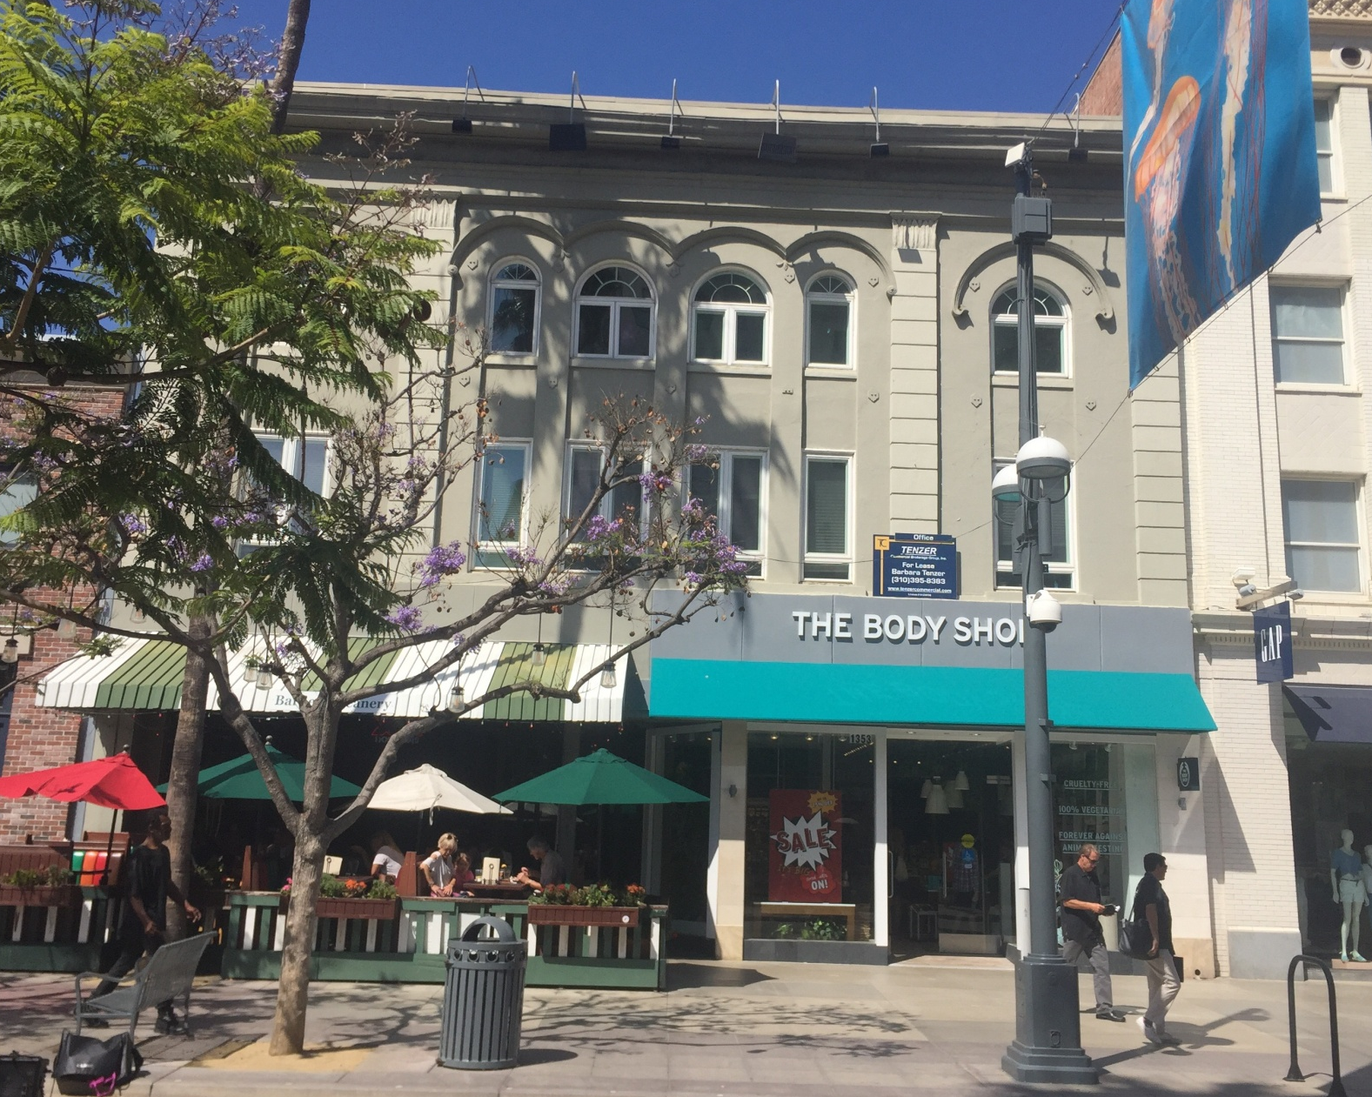
Office for Lease
1351 Third Street Promenade, Suite #206
Santa Monica, CA
Tenzer Commercial Brokerage Group Inc
1334 Third Street Promenade, Suite 306, Santa Monica, CA 90401 Tel 310.395.8383 F 310.395.7872
This Statement with the information it contains is given with the understanding that all negotiations relating to the purchase, renting, or leasing of t he property above shall be conducted through this office. The above information while not guaranteed has been secured from sources we believe to be reliable

Slide 2
Office for Lease
1351 Third Street Promenade, Suite #206
Santa Monica, CA
Tenzer Commercial Brokerage Group Inc
Barbara Tenzer
310.395.8383
B.tenzercommercial@gmail.com
License# 01235150
Rana Zeyada
310.395.8383
R.tenzercommercial@gmail.com
License# 02006069
Asking Rent: $3.85/SF
Size: Approx. 2,495 SF
Available: ASAP
Utilities: The office is separately metered. Tenant Pays for electricity. Landlord pays
for water & janitorial.
Office Description: See attached floor plan. Best office location in Santa Monica.
The premises has brick walls, sky light, and operable windows. Easy access to
restaurants and parking.
Comments: Landlord can demo the existing offices and create an open space
layout, if desired.
1334 Third Street Promenade, Suite 306, Santa Monica, CA 90401 Tel 310.395.8383 F 310.395.7872
This Statement with the information it contains is given with the understanding that all negotiations relating to the purchase, renting, or leasing of t he property above shall be conducted through this office. The above information while not guaranteed has been secured from sources we believe to be reliable

Slide 3
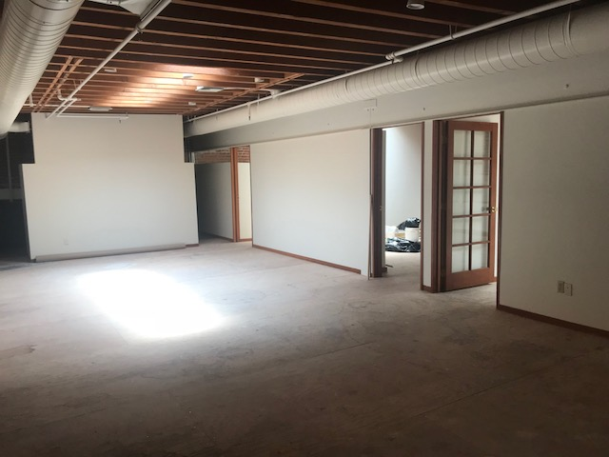
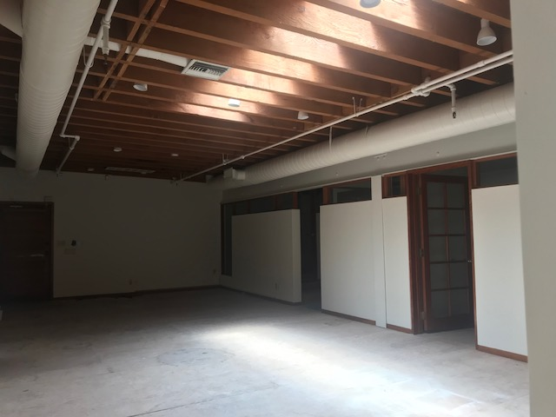
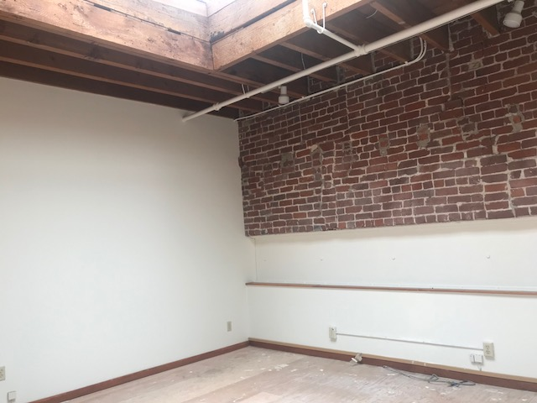
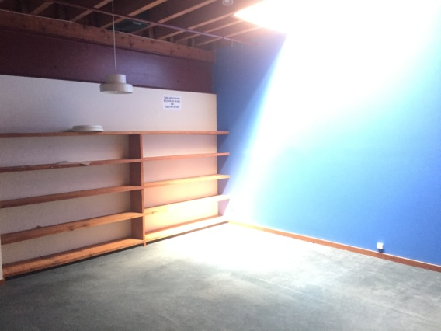
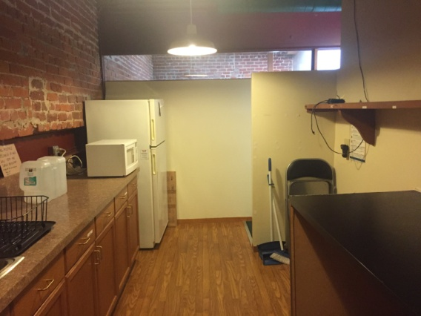
Office for Lease
1351 Third Street Promenade, Suite #206
Santa Monica, CA
Tenzer Commercial Brokerage Group Inc

Slide 4
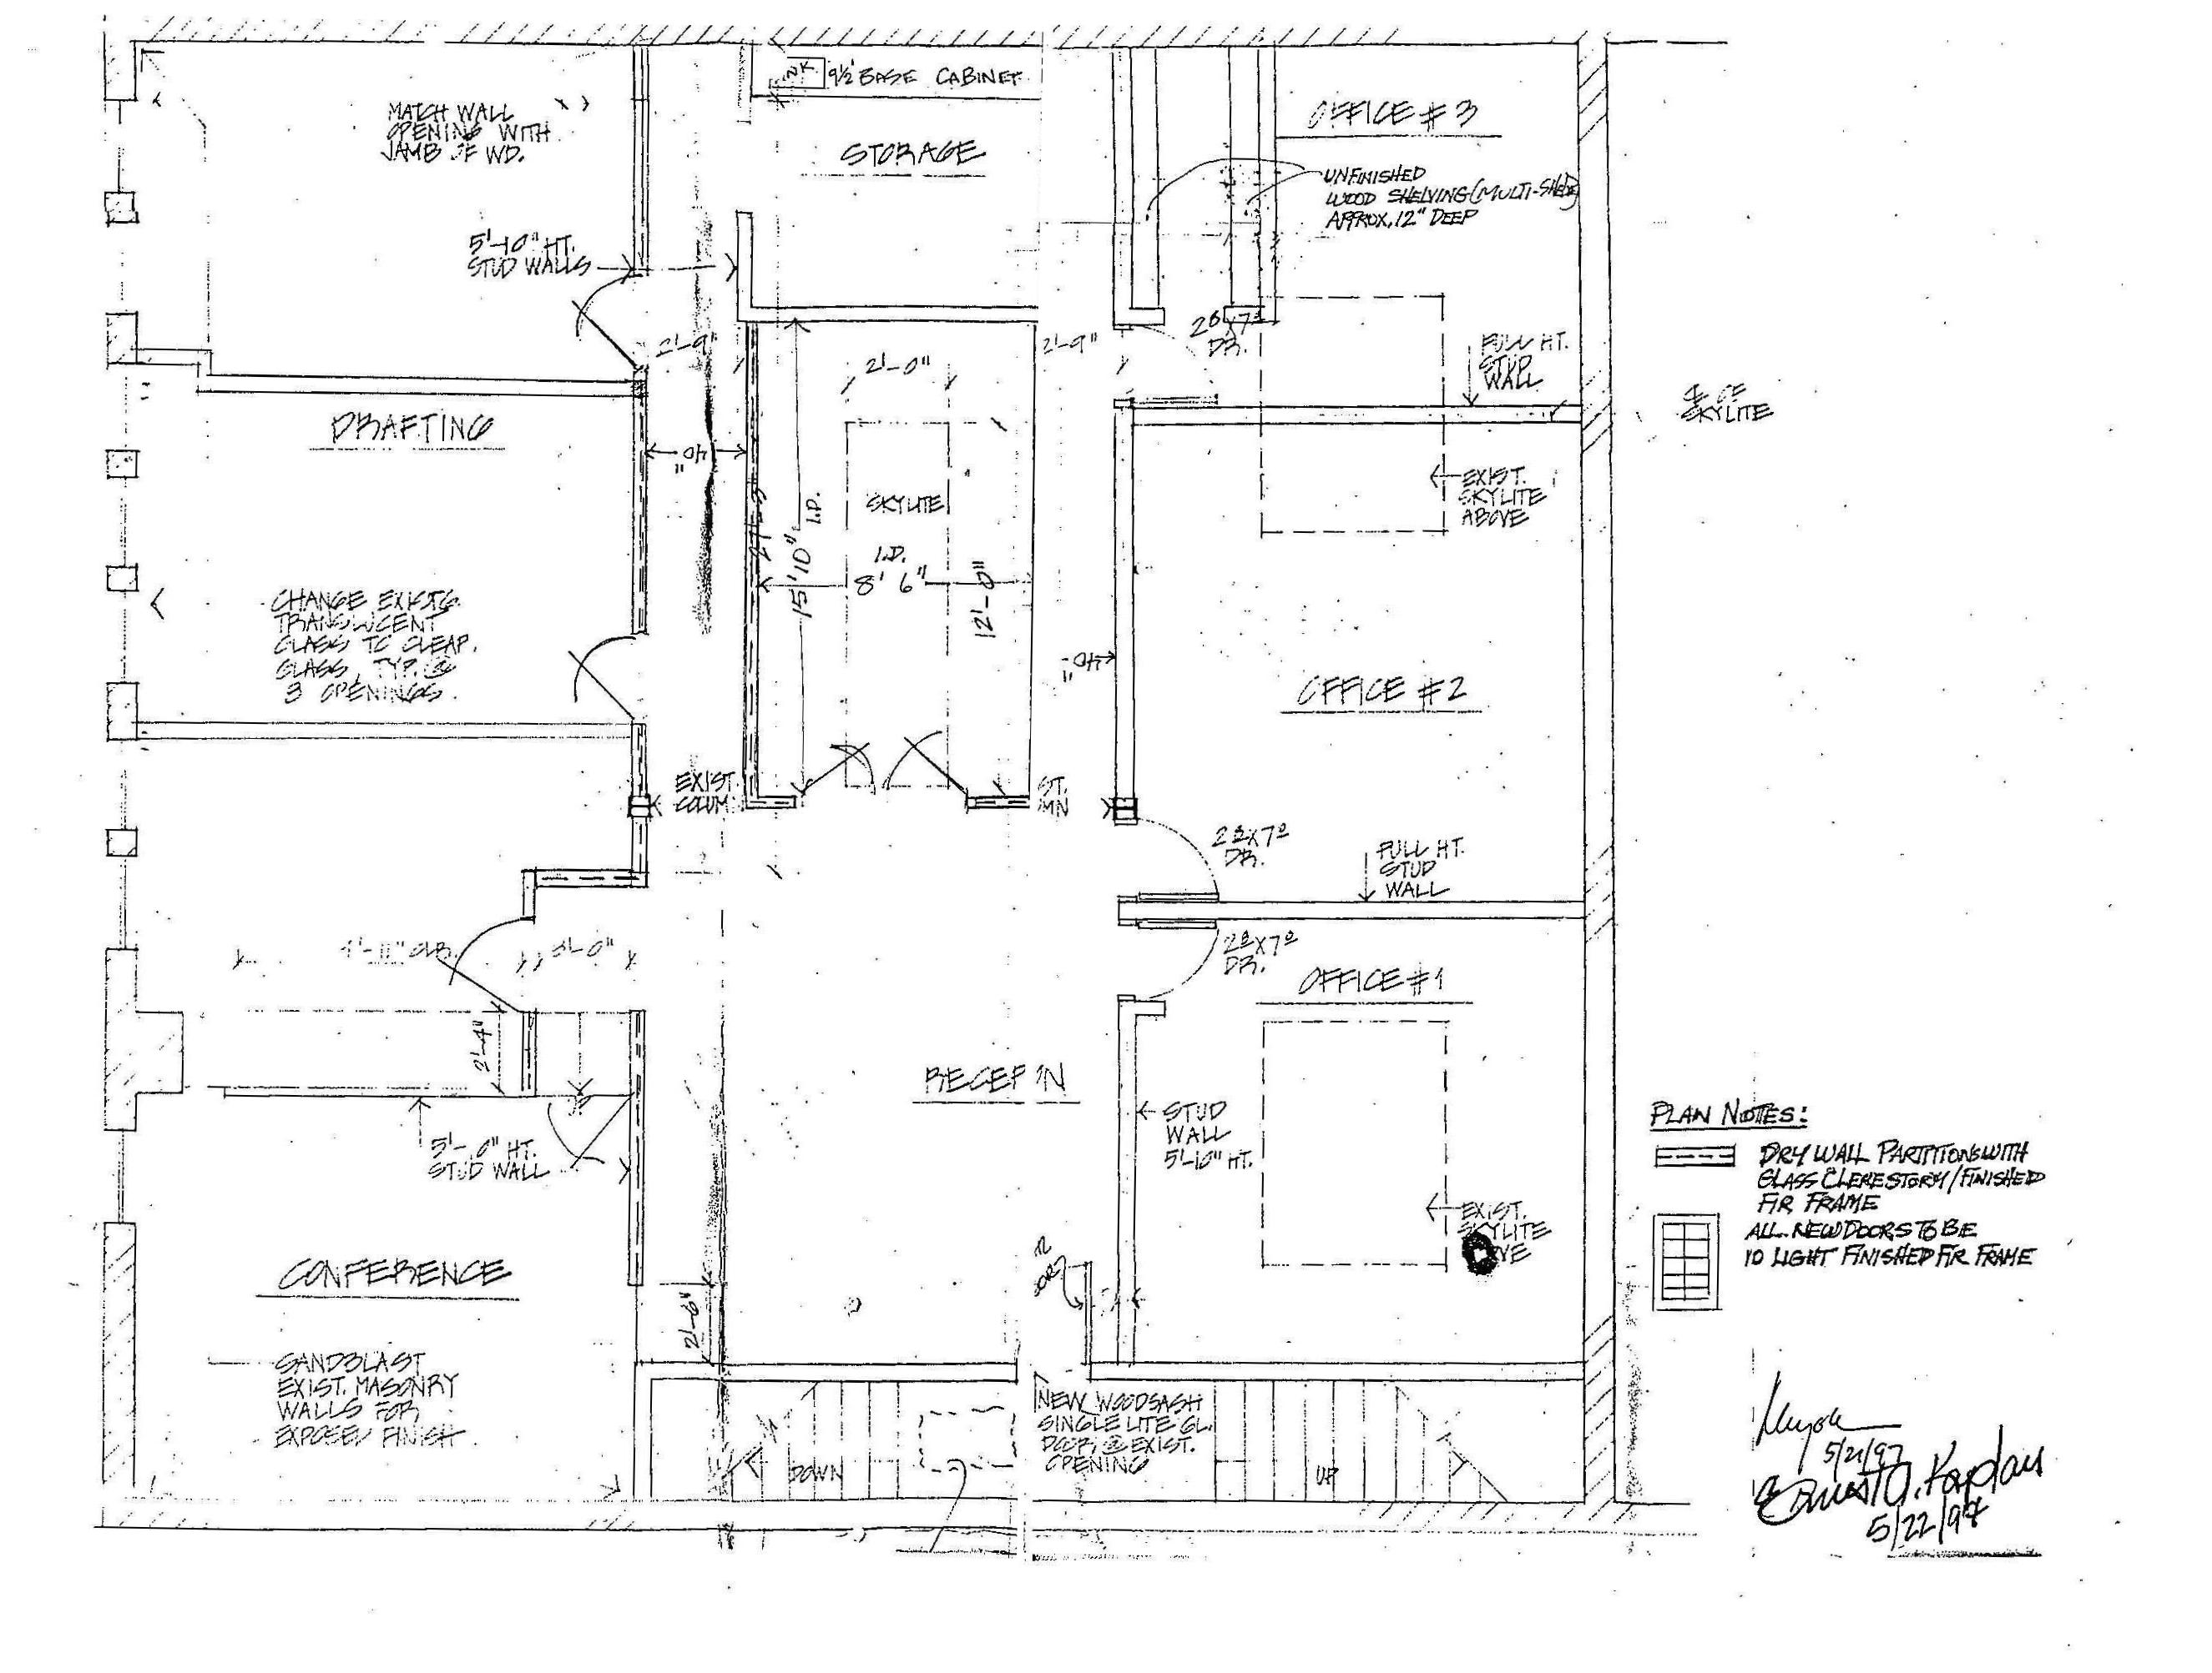
Office for Lease
1351 Third Street Promenade, Suite #206
Santa Monica, CA
Tenzer Commercial Brokerage Group Inc
Floor Plan
1334 Third Street Promenade, Suite 306, Santa Monica, CA 90401 Tel 310.395.8383 F 310.395.7872
This Statement with the information it contains is given with the understanding that all negotiations relating to the purchase, renting, or leasing of t he property above shall be conducted through this office. The above information while not guaranteed has been secured from sources we believe to be reliable

Slide 5
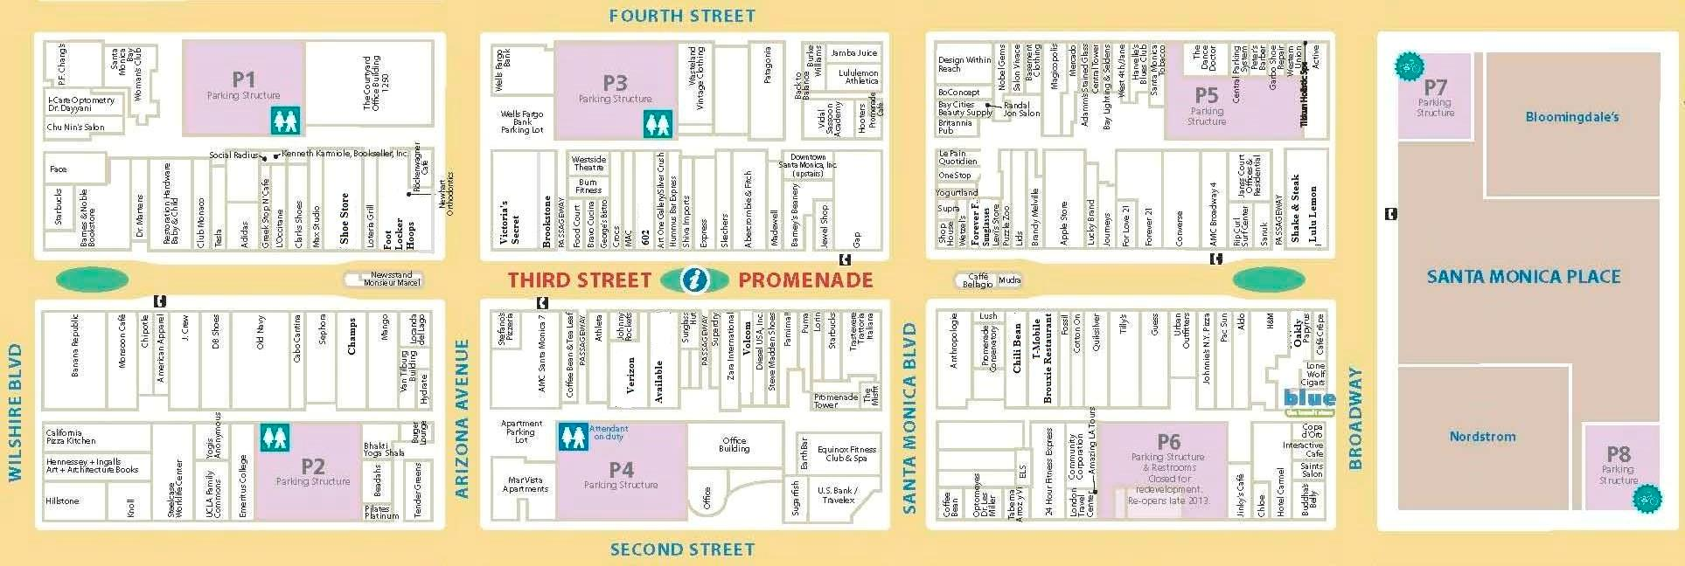
Office for Lease
1351 Third Street Promenade, Suite #206
Santa Monica, CA
Tenzer Commercial Brokerage Group Inc
Map
1351 Third Street Promenade
Area Demographics
Estimated Day time
Population
1 Mile: 58,278
3 Miles: 199,034
5 Miles: 499,730
Average Household
Income
1 Mile: $103,598
3 Miles: $126,343
5 Miles: $125,583
Total Households
1 Mile: 18,940
3 Miles: 79,942
5 Miles: 182,099
1334 Third Street Promenade, Suite 306, Santa Monica, CA 90401 Tel 310.395.8383 F 310.395.7872
This Statement with the information it contains is given with the understanding that all negotiations relating to the purchase, renting, or leasing of t he property above shall be conducted through this office. The above information while not guaranteed has been secured from sources we believe to be reliable

Slide 6
Office for Lease
1351 Third Street Promenade, Suite #206
Santa Monica, CA
Tenzer Commercial Brokerage Group Inc
Facts about downtown Santa Monica:
This is the perfect location to have an office.
The famous Third Street Promenade, an open air, pedestrian-only street features dozens of retailers, offers great street entertainment as well as outdoor movie screenings and a weekly farmers market. There are more than a hundred restaurants in the downtown area.
The Third Street Promenade attracts nearly 24 million visitors each year who are drawn to the shopping, dining, theaters and live street performers. These visitors spend approximately $1.6 billion annually and consist of approximately 60% tourists and 40% locals.
The new Expo Light Rail Line is just a few blocks away..
1334 Third Street Promenade, Suite 306, Santa Monica, CA 90401 Tel 310.395.8383 F 310.395.7872
This Statement with the information it contains is given with the understanding that all negotiations relating to the purchase, renting, or leasing of t he property above shall be conducted through this office. The above information while not guaranteed has been secured from sources we believe to be reliable

